Slide 1



深度學習 Deep Learning
可解釋性人工智慧
Explainable AI
Instructor: 林英嘉 (Ying-Jia Lin)
2025/05/19
Course GitHub
Slido # DL_0519

Slide 2
Outline
Introduction
Class-activation Map (CAM)
Grad-CAM
Code

Slide 3
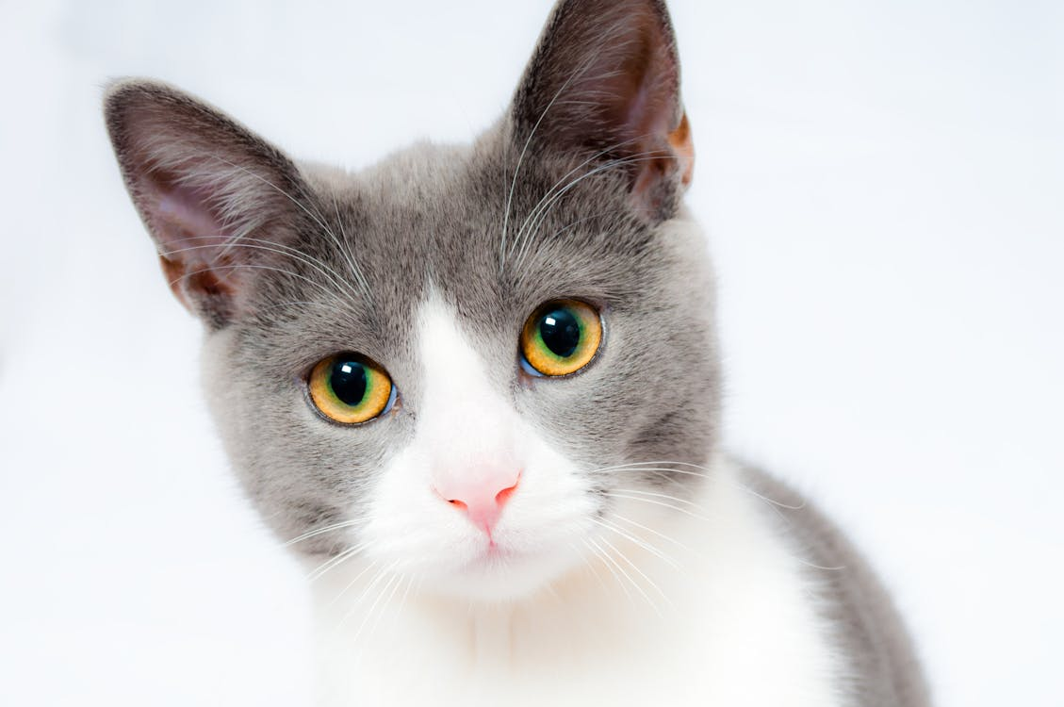


Prediction of a Machine Learning Model
Machine Learning function
Cat
模型可能看到
Why?
Dog
模型可能看到
黑箱作業

Slide 4
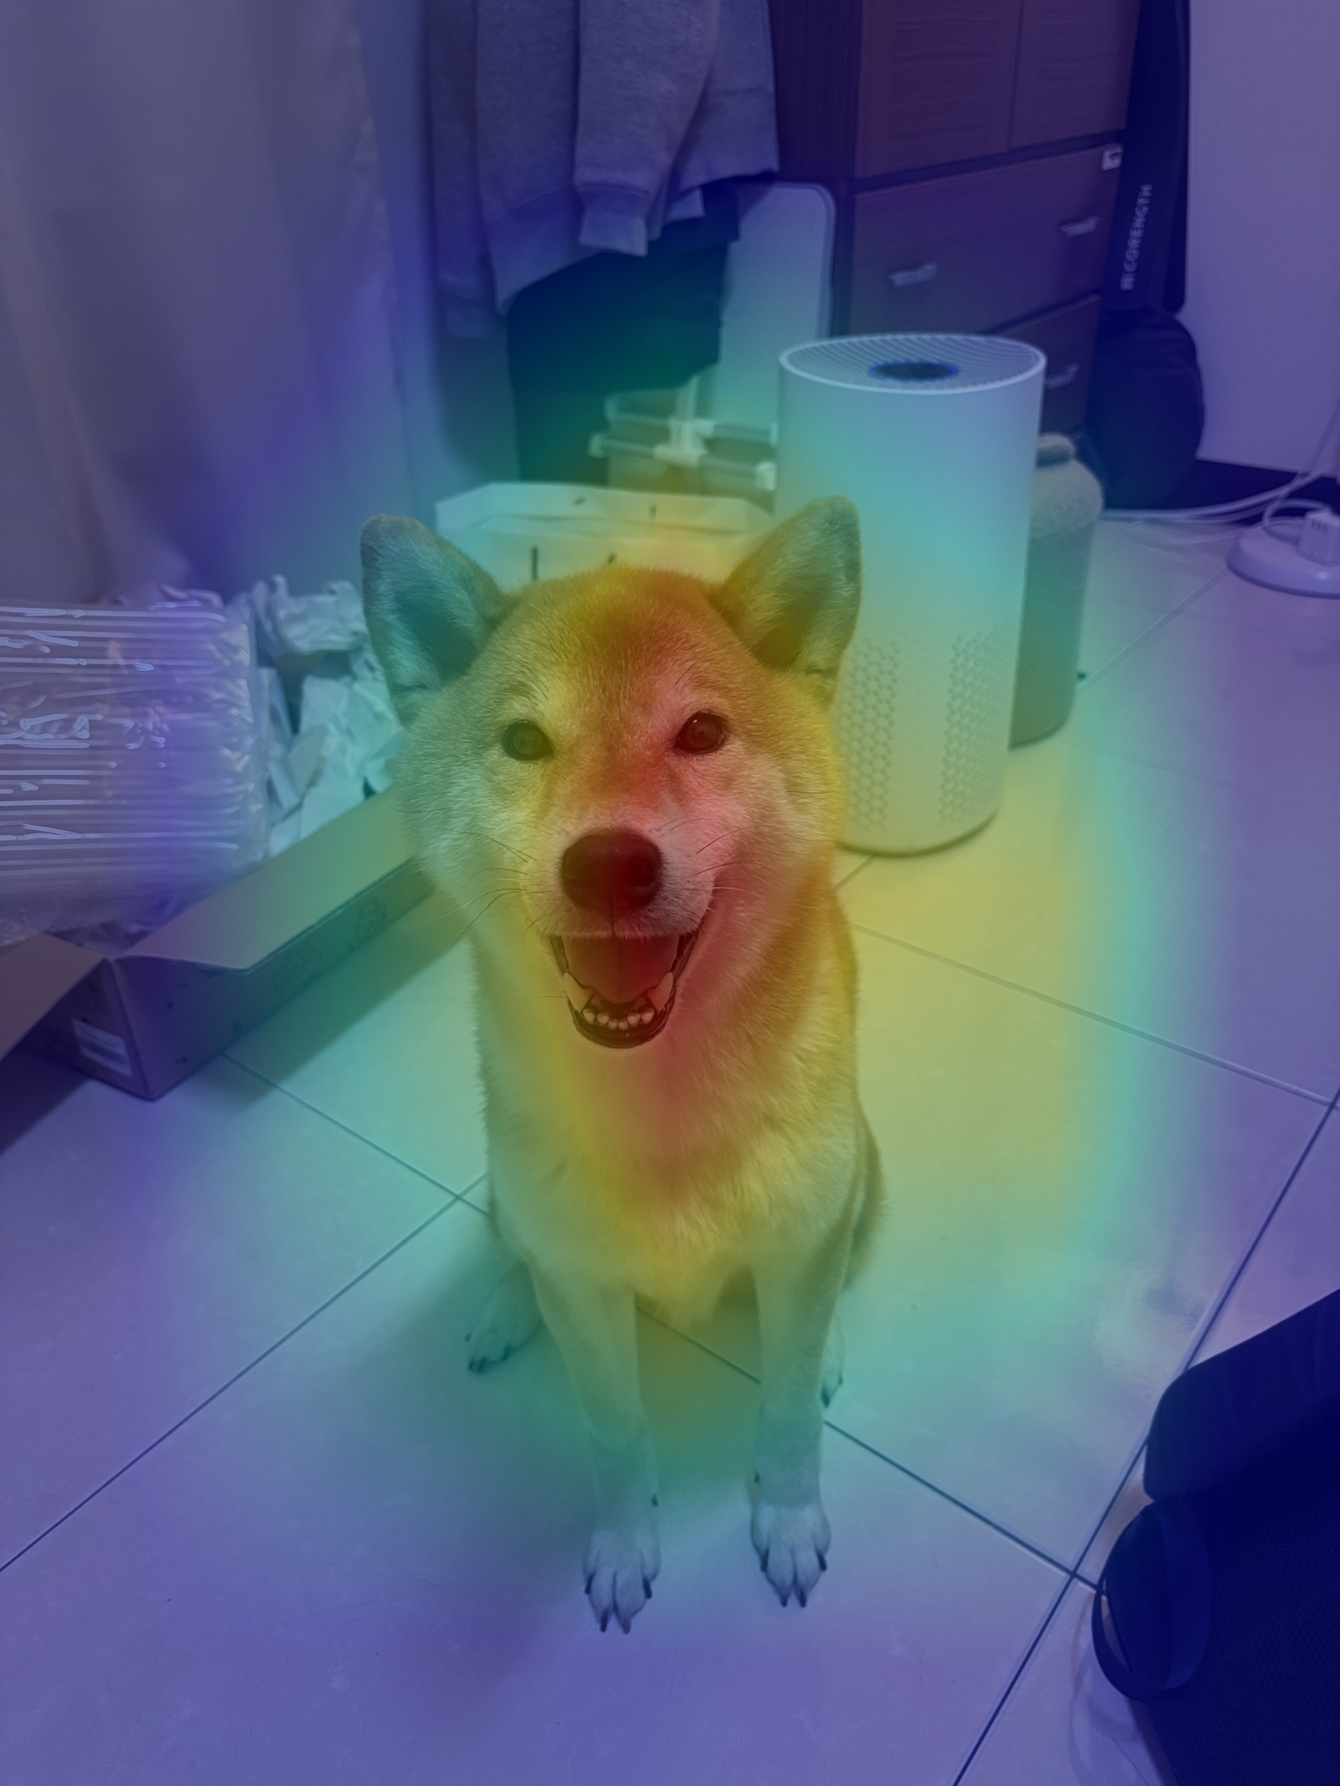
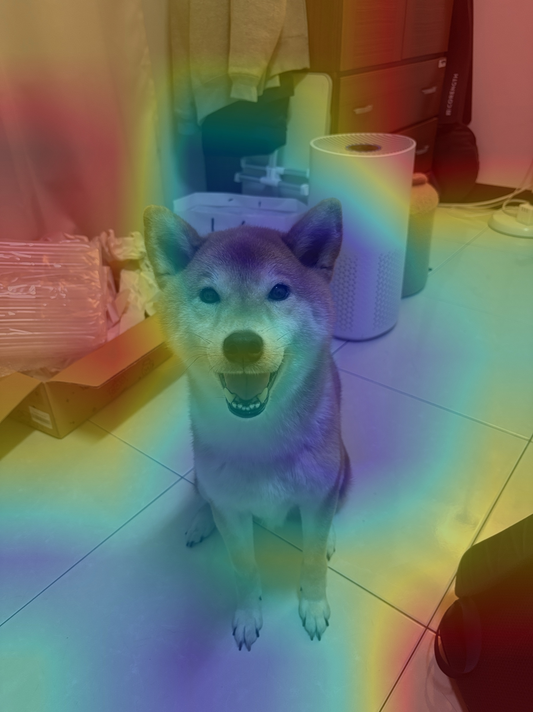

Example: Classification
Test model: resnet18 pre-trained on ImageNet-1K
Method: Class activation map (CAM)
Input Image
Pembroke Welsh Corgi
window shade

Slide 5
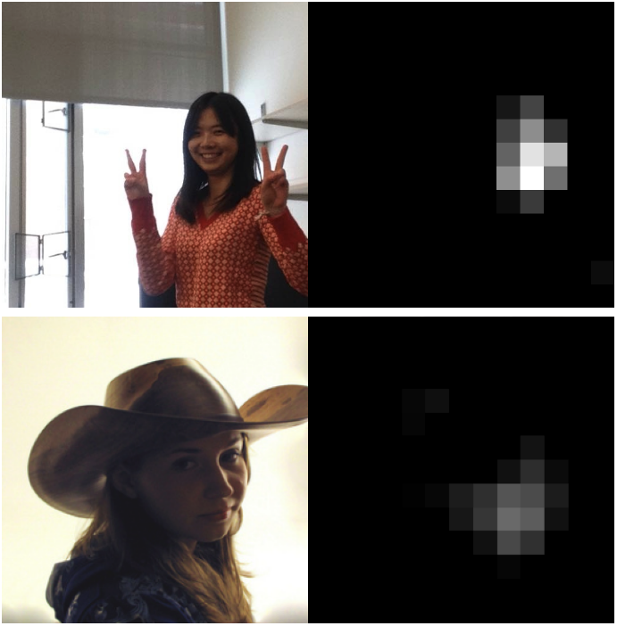
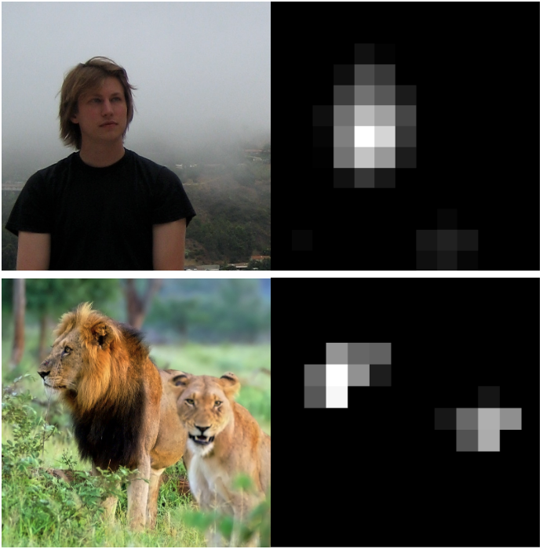
Visualizing Feature Maps in a CNN
151st channel on the conv5 layer of a deep neural network trained on ImageNet
Figure source: Yosinski, Jason, et al. “Understanding neural networks through deep visualization.” 2015 ICML Deep Learning Workshop.

Slide 6
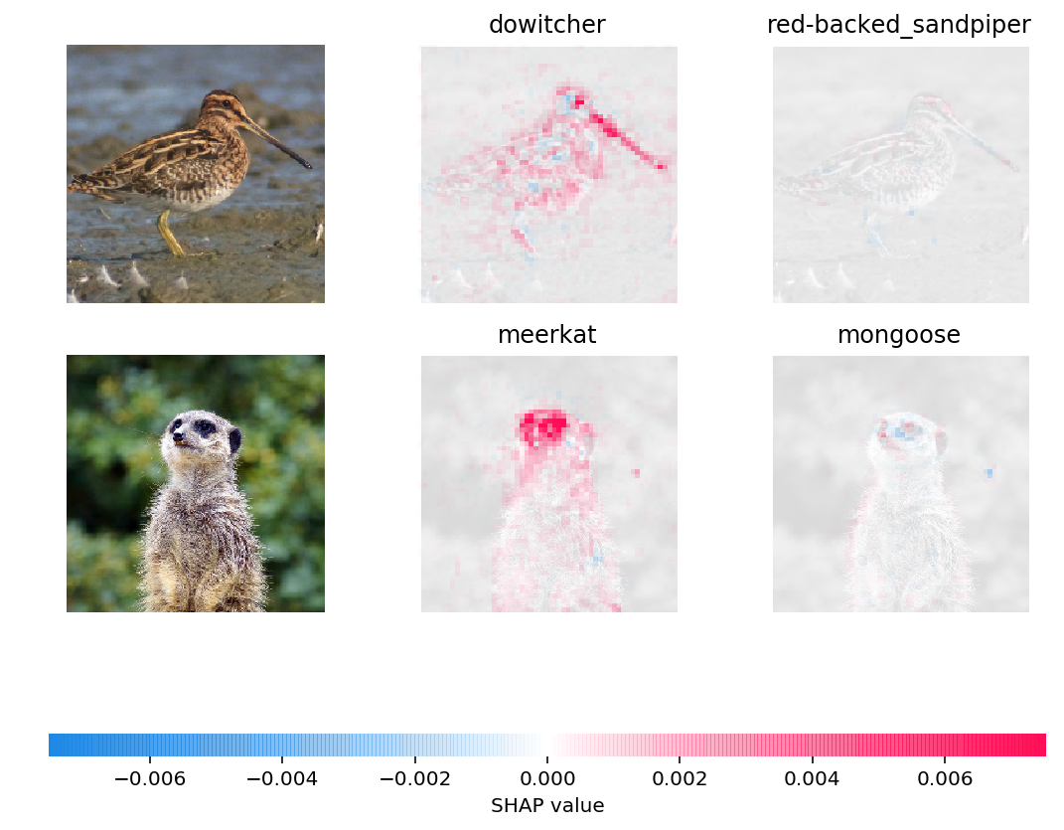
Example with SHAP
半蹼鷸屬
鷸科
Figure source: https://github.com/shap/shap
狐獴
獴科

Slide 7
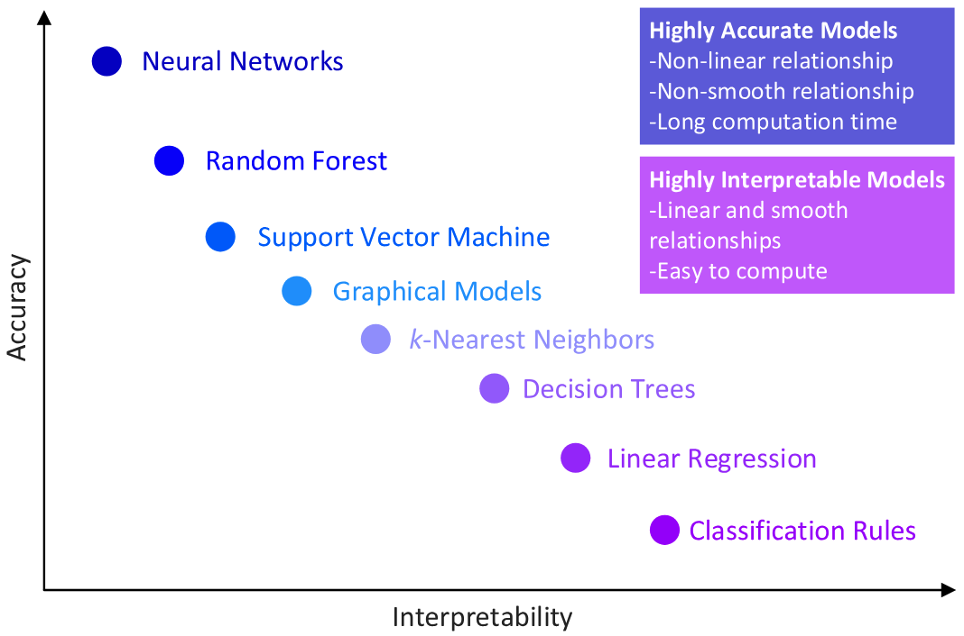
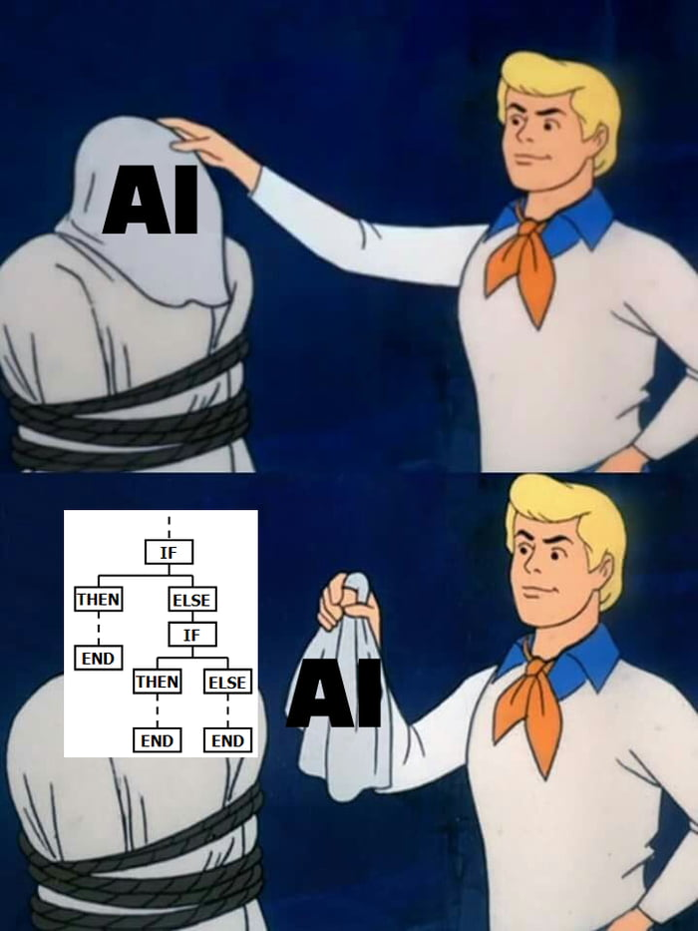
模型的可解釋性與效能
Figure source: Morocho-Cayamcela, Manuel Eugenio, Haeyoung Lee, and Wansu Lim. "Machine learning for 5G/B5G mobile and wireless communications: Potential, limitations, and future directions." IEEE access 7 (2019): 137184-137206.
Figure source:
https://9gag.com/gag/aOYA1mE?ref=pn.mw

Slide 8
Why is Explainable AI important?
確認機器學習模型的判斷合理
建立信任 (使用者 / 政府)
改進機器學習模型
從模型輸出找出改進的策略
https://www.ibm.com/think/topics/explainable-ai

Slide 9
Convolutional Neural Networks (Recap)

Slide 10
[Recap] The whole Process of a CNN
CNN: Convolutional Neural Networks
Convolution
Pooling
Flatten
BatchNorm
BatchNorm
Fully-connected Networks
Pooling
Convolution
…
Convolution
Classification
BatchNorm
Pooling

Slide 11
[Recap] Convolutions (stride = 1)
Element-wise multiplication
Stride = 1
1 | 1 | 1 | 1 | 0 | 0
0 | 1 | 1 | 0 | 1 | 0
0 | 0 | 1 | 1 | 0 | 0
0 | 0 | 1 | 1 | 1 | 0
0 | 0 | 0 | 1 | 1 | 0
0 | 0 | 0 | 0 | 0 | 0
1 | 0 | 0
0 | 1 | 0
0 | 0 | -1
1
Filter

Slide 12
[Recap] Convolutions (stride = 1)
Element-wise multiplication
Stride = 1
1 | 1 | 1 | 1 | 0 | 0
0 | 1 | 1 | 0 | 1 | 0
0 | 0 | 1 | 1 | 0 | 0
0 | 0 | 1 | 1 | 1 | 0
0 | 0 | 0 | 1 | 1 | 0
0 | 0 | 0 | 0 | 0 | 0
1 | 0 | 0
0 | 1 | 0
0 | 0 | -1
1 | 1 | 1 | 2
-1 | 1 | 1 | 0
0 | 0 | 1 | 2
0 | 0 | 1 | 2
Filter
feature map

Slide 13
[Recep] 2x2 Pooling (example of Max Pooling)
1 | 3 | 1 | 2
-1 | 1 | 1 | 0
0 | 1 | 1 | 0
0 | 0 | 1 | 2
3 | 2
1 | 2
參數：
kernel_size=2
stride = 2

Slide 14
[Recep] 2x2 Pooling (example of Average Pooling)
1 | 3 | 1 | 2
-1 | 1 | 1 | 0
0 | 1 | 1 | 0
0 | 0 | 1 | 2
1 | 1
0.25 | 1
參數：
kernel_size=2
stride = 2

Slide 15
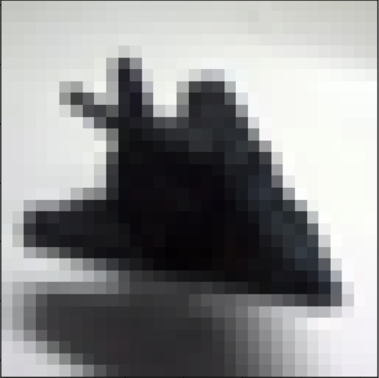
[Recap] Convolutional Neural Networks (CNN)
*維度意義：(C, H, W)
CGUDL_2025_Spring/code/pytorch_mnist.ipynb
(32, 32, 32)
(32, 16, 16)
(64, 16, 16)
(64, 8, 8)
Conv1
2x2 Max Pooling
Conv2
2x2 Max Pooling
…
…
…
…
(3, 32, 32)
Conv3
128*4*4
10
(128, 8, 8)
(128, 4, 4)
2x2 Max Pooling
Flattening
Softmax
…
…
Classification
…
…
Full-connected (FC) layer

Slide 16
[Recap] FC layer 參數量
FC: fully-connected
128*4*4
10
RGB images | 參數量比較 (不算 bias 數)
FC layer | 128* 4 * 4 * 10 = 20480
Softmax
…
…
Classification
Full-connected (FC) layer
如果不要拉平 (flattening) 呢？

Slide 17
Global Average Pooling (GAP)
Feature Map
1 | 3 | 1 | 2
-1 | 1 | 1 | 0
0 | 1 | 1 | 0
0 | 0 | 1 | 2
全局數值取平均
0.8125
(13/16)
一張 feature map
經過GAP後變成一個數值
Lin, Min, Qiang Chen, and Shuicheng Yan. “Network in network.” ICLR 2014.

Slide 18
CNN with Global Average Pooling (GAP)
*維度意義：(C, H, W)
(32, 32, 32)
(32, 16, 16)
(64, 16, 16)
(64, 8, 8)
Conv1
2x2 Max Pooling
Conv2
2x2 Max Pooling
…
…
…
…
(3, 32, 32)
Conv3
128
10
(128, 8, 8)
(128, 4, 4)
2x2 Max Pooling
GAP
Softmax
…
…
Classification
…
…
Full-connected (FC) layer

Slide 19
加入 GAP 後參數量下降
FC: fully-connected
Original version
GAP version
128*4*4
10
128
10
Softmax
Softmax
…
…
Classification
…
…
Classification
Full-connected (FC) layer
Full-connected (FC) layer
RGB images | 參數量比較 (不算 bias 數)
Original | 128* 4 * 4 * 10 = 20480
GAP | 128 * 10 = 1280

Slide 20
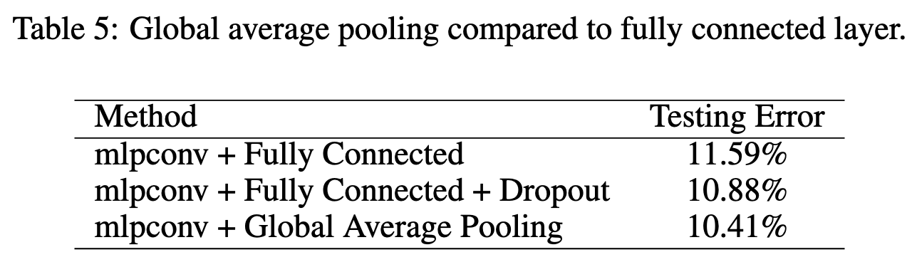
加入 GAP 後 Testing Error 下降
Original
*Dropout 也是減少FC layer中node連接數量的方法
Lin, Min, Qiang Chen, and Shuicheng Yan. “Network in network.” ICLR 2014.

Slide 21
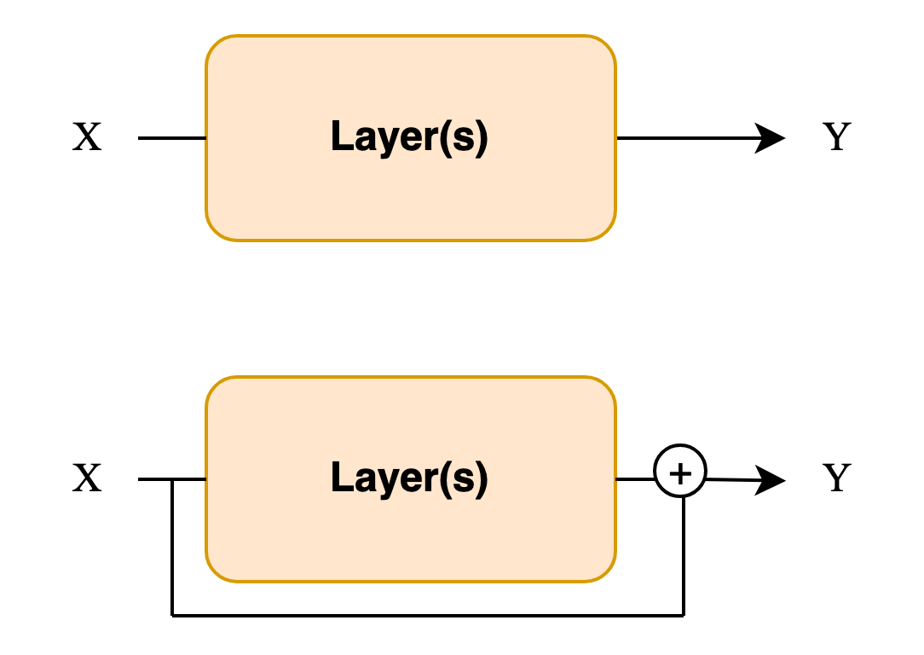
ResNet 架構
https://arxiv.org/abs/1512.03385
(Recap)
ResNet 的最後也是 GAP + FC
Standard
Residual
He, Kaiming, et al. "Deep residual learning for image recognition." Proceedings of the IEEE conference on computer vision and pattern recognition (2016).

Slide 22
Class-activation Map (CAM)

Slide 23
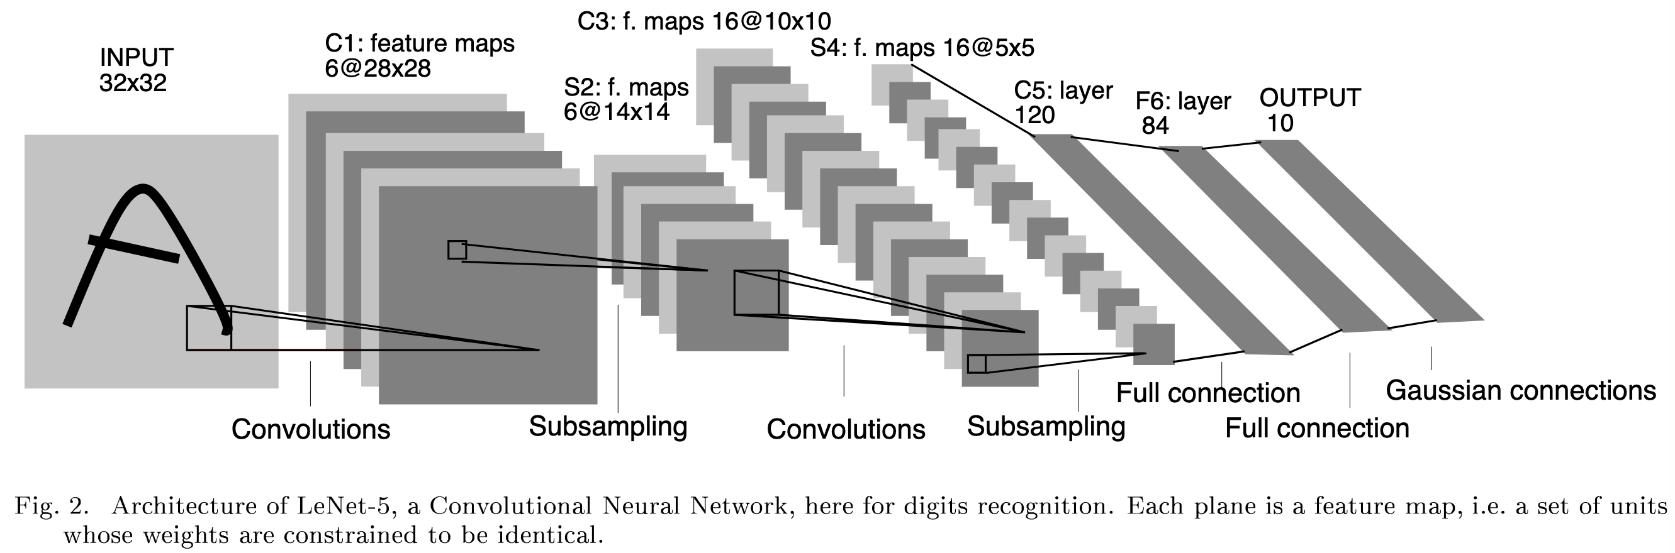
[Recap] Convolutional Neural Networks (CNN)
Pooling
Pooling
FC layers
LeCun, Y., Bottou, L., Bengio, Y., & Haffner, P. (1998). Gradient-based learning applied to document recognition. Proceedings of the IEEE, 86(11), 2278-2324.

Slide 24

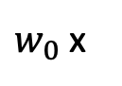
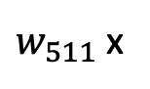
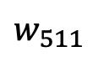
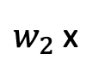
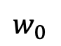
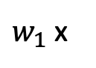
Class-activation Map (CAM)
*假設使用 ImageNet pre-trained model
512
1000
(512, 7, 7)
$$w_{0}$$
$$w_{511}$$
...
GAP
Softmax
Pooling
Convolution
Pooling
Convolution
…
…
Classification
…
Full-connected (FC) layer
放大回原本size
套色
$w_{0}$ x
+
$w_{1}$ x
+
$w_{2}$ x
+ . . . +
$w_{511}$ x
疊圖
Zhou, Bolei, et al. "Learning deep features for discriminative localization." Proceedings of the IEEE conference on computer vision and pattern recognition. 2016.

Slide 25
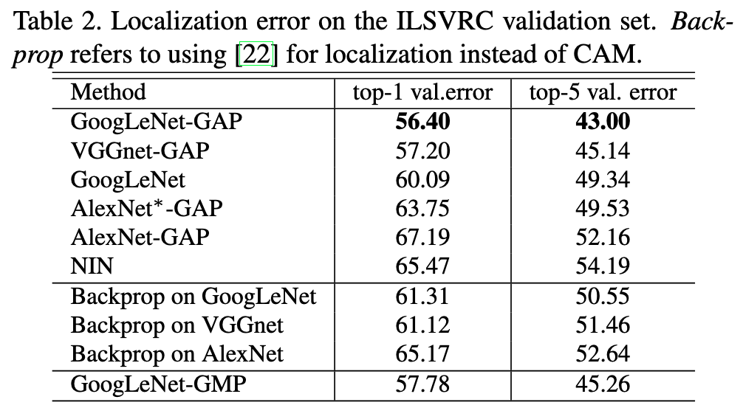
Why Global “Average” Pooling?
How about Global “Summation” Pooling?
How about Global “Max” Pooling (GMP)?
Zhou, Bolei, et al. "Learning deep features for discriminative localization." Proceedings of the IEEE conference on computer vision and pattern recognition. 2016.

Slide 26
CAM 的問題
512
1000
(512, 7, 7)
...
GAP
Softmax
Pooling
Convolution
Pooling
Convolution
…
…
Classification
…
Full-connected (FC) layer
不是每個模型最後面都是 GAP + FC
(E.g., VGG-16 的最後是 3 層 FC、ViT 的最後只有 FC)

Slide 27
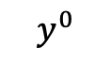
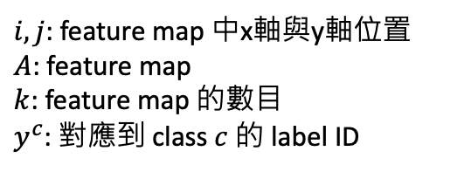
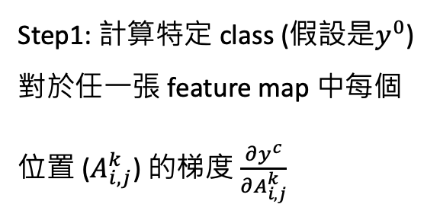
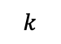
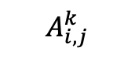
Grad-CAM (1)
$i,j$: feature map 中x軸與y軸位置
$A$: feature map
$k$: feature map 的數目
$y^{c}$: 對應到 class $c$ 的 label ID
Grad: gradients
1000
$$y^{0}$$
Step1: 計算特定 class (假設是$y^{0}$) 對於任一張 feature map 中每個位置 ($A_{i,j}^{k}$) 的梯度 $\frac{∂y^{c}}{∂A_{i,j}^{k}}$
Model
…
…
$$k$$
能夠產生Feature maps的最後一層
Feature maps
分類層
$$A_{i,j}^{k}$$
Selvaraju, Ramprasaath R., et al. "Grad-cam: Visual explanations from deep networks via gradient-based localization." Proceedings of the IEEE international conference on computer vision. 2017.

Slide 28

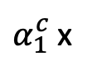
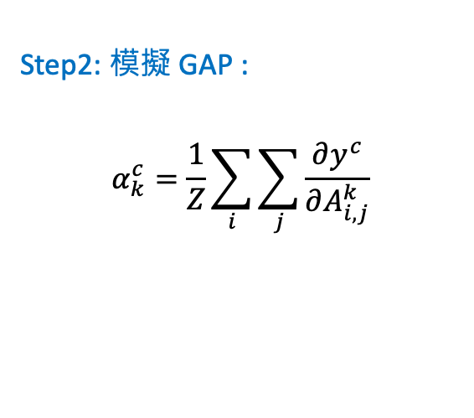
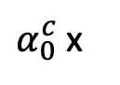
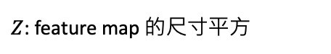
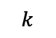
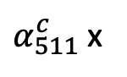

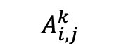
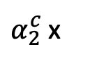
Grad-CAM (2)
1000
Step2: 模擬 GAP :
$$α_{k}^{c}=\frac{1}{Z}\sum_{i}{\sum_{j}{\frac{∂y^{c}}{∂A_{i,j}^{k}}}}$$
Model
…
…
$$k$$
能夠產生Feature maps的最後一層
Feature maps
分類層
$Z$: feature map 的尺寸平方
$$A_{i,j}^{k}$$
Step3: 把Feature maps根據$α_{k}^{c}$相加
放大回原本size
套色
$$ReLU($$
$$)$$
$α_{0}^{c}$x
+
$α_{1}^{c}$x
+
$α_{2}^{c}$x
+ . . . +
$α_{511}^{c}$x
疊圖
Step4: ReLU
Zhou, Bolei, et al. "Learning deep features for discriminative localization." Proceedings of the IEEE conference on computer vision and pattern recognition. 2016.

Slide 29
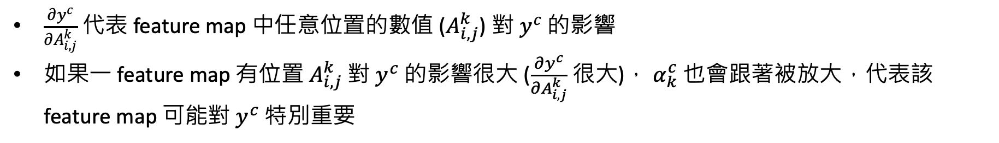
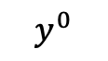
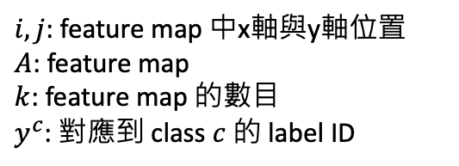
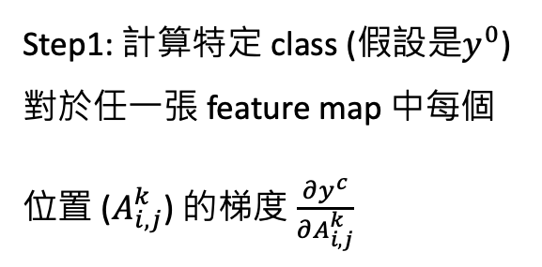
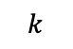
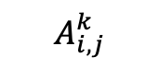
為什麼要使用梯度？
$i,j$: feature map 中x軸與y軸位置
$A$: feature map
$k$: feature map 的數目
$y^{c}$: 對應到 class $c$ 的 label ID
1000
$$y^{0}$$
Step1: 計算特定 class (假設是$y^{0}$) 對於任一張 feature map 中每個位置 ($A_{i,j}^{k}$) 的梯度 $\frac{∂y^{c}}{∂A_{i,j}^{k}}$
Model
…
…
$$k$$
能夠產生Feature maps的最後一層
Feature maps
分類層
$$A_{i,j}^{k}$$
$\frac{∂y^{c}}{∂A_{i,j}^{k}}$ 代表 feature map 中任意位置的數值 ($A_{i,j}^{k}$) 對 $y^{c}$ 的影響
如果一 feature map 有位置 $A_{i,j}^{k}$ 對 $y^{c}$ 的影響很大 ($\frac{∂y^{c}}{∂A_{i,j}^{k}}$ 很大)， $α_{k}^{c}$ 也會跟著被放大，代表該 feature map 可能對 $y^{c}$ 特別重要

Slide 30
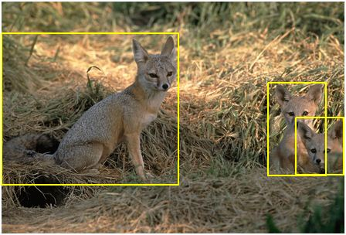
Automatic Evaluations
Annotated datasets
ILSVRC (ImageNet Large Scale Visual Recognition Challenge) Localization
Human Evaluation
Figure source: https://www.kaggle.com/c/imagenet-object-localization-challenge/overview/description

Slide 31
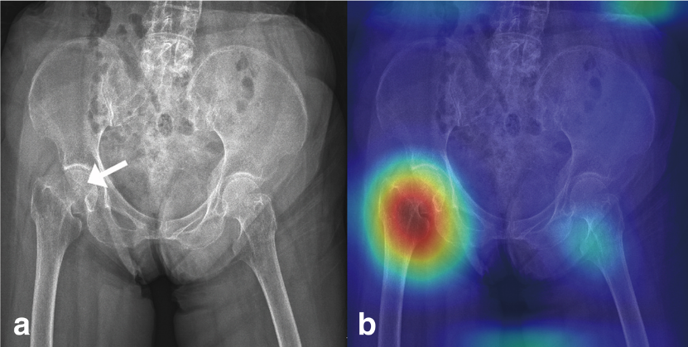
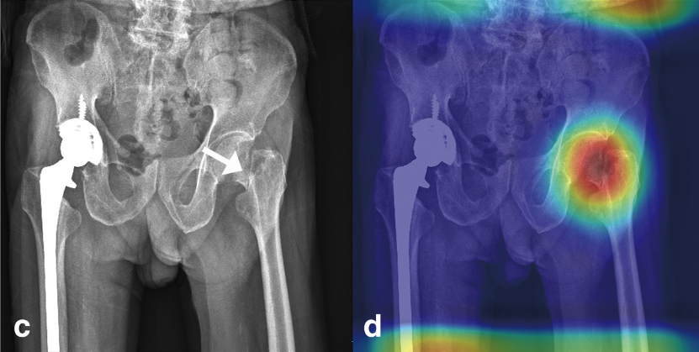
Example: Medical Image Classification
Pelvic X-ray fracture classification with Grad-CAM
Cheng, Chi-Tung, et al. "Application of a deep learning algorithm for detection and visualization of hip fractures on plain pelvic radiographs." European radiology 29.10 (2019): 5469-5477.

Slide 32
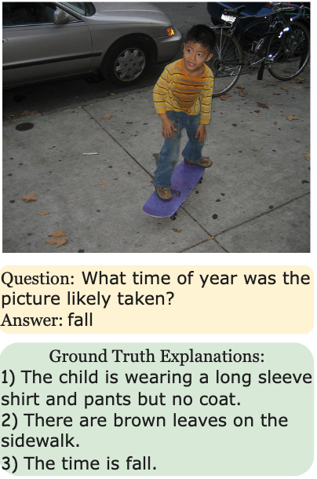
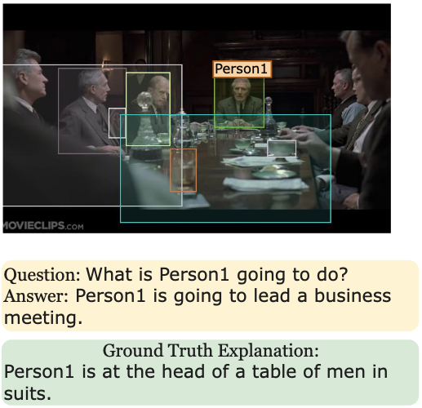
Example: VQA (Visual Question Answering)
Whitehouse, Chenxi, Tillman Weyde, and Pranava Swaroop Madhyastha. "Towards a Unified Model for Generating Answers and Explanations in Visual Question Answering." Findings of EACL 2023.
VQA with explanations

Slide 33
重要論文
Network In Network: https://arxiv.org/abs/1312.4400
Class-activation Map (CAM): https://arxiv.org/abs/1512.04150
Grad-CAM: https://arxiv.org/abs/1610.02391
SHAP: https://arxiv.org/abs/1705.07874
Guided back-propagation: https://arxiv.org/pdf/1412.6806

Slide 34
延伸主題
可不可以完全不要FC layers?

Slide 35
FC layers 會大量增加參數
Convolution
Pooling
Flatten
BatchNorm
BatchNorm
Fully-connected Networks
Pooling
Convolution
…
可不可以不要FC layers?
Convolution
Classification
BatchNorm
Pooling

Slide 36
完全沒有採用 FC layers 的模型 (論文)
Network In Network: https://arxiv.org/abs/1312.4400
SqueezeNet: AlexNet-level accuracy with 50x fewer parameters and <0.5MB model size (ICLR 2017): https://openreview.net/forum?id=S1xh5sYgx

Slide 37
Channels 數目調整
*維度意義：(C, H, W)
PyTorch 寫法
Filters 參數 (weights) 數量
(128, 4, 4)
(10, 4, 4)
torch.nn.Conv2d(
in_channels=128,
out_channels=10,
kernel_size=3,
padding=1,
)
128*10*3*3 = 11,520
3x3
Conv
…
(128, 4, 4)
(10, 4, 4)
1 x 1 convolution
torch.nn.Conv2d(
in_channels=128,
out_channels=10,
kernel_size=1,
padding=0,
)
1x1
Conv
128*10*1*1 = 1,280
…
Reference: https://docs.pytorch.org/docs/stable/generated/torch.nn.Conv2d.html

Slide 38
1 x 1 Convolution
Stride = 1
1 | 1 | 1 | 1 | 0 | 0
0 | 1 | 1 | 0 | 1 | 0
0 | 0 | 1 | 1 | 0 | 0
0 | 0 | 1 | 1 | 1 | 0
0 | 0 | 0 | 1 | 1 | 0
0 | 0 | 0 | 0 | 0 | 0
1
1
1
1
0
0
1
Filter
(假設數值為1)

Slide 39
CNN with Global Average Pooling (GAP)
*維度意義：(C, H, W)
(32, 32, 32)
(32, 16, 16)
(64, 16, 16)
(64, 8, 8)
Conv1
2x2 Max Pooling
Conv2
2x2 Max Pooling
…
…
…
…
(3, 32, 32)
Conv3
(128, 8, 8)
(128, 4, 4)
(10, 4, 4)
2x2 Max Pooling
Conv3
GAP
Classification
…
…
(調整通道數)
Softmax

Slide 40
PyTorch

Slide 41
Class-activation Map (CAM)
*假設使用 ImageNet pre-trained model
512
1000
(512, 7, 7)
$$w_{0}$$
$$w_{511}$$
...
GAP
Softmax
Pooling
Convolution
Pooling
Convolution
…
…
Classification
…
Full-connected (FC) layer
需要取得中間輸出
放大回原本size
套色
$w_{0}$ x
+
$w_{1}$ x
+
$w_{2}$ x
+ . . . +
$w_{511}$ x
疊圖
Zhou, Bolei, et al. "Learning deep features for discriminative localization." Proceedings of the IEEE conference on computer vision and pattern recognition. 2016.

Slide 42
register_forward_hook
hook
512
1000
🪝
(512, 7, 7)
...
GAP
Softmax
Pooling
Convolution
Pooling
Convolution
…
…
Classification
…
Full-connected (FC) layer
features_maps = []
👛
https://docs.pytorch.org/docs/stable/generated/torch.nn.Module.html#torch.nn.Module.register_forward_hook

Slide 43
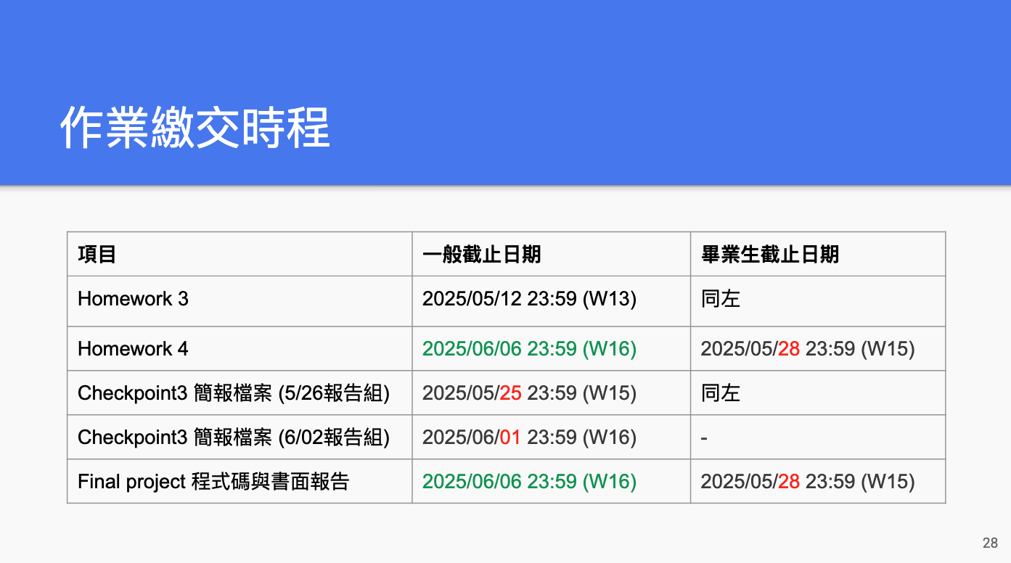

Slide 44
Week 15 / Week 16 之前要繳交什麼？
一組繳交一份，請上傳至 Teams
檔名：DL_teamN_checkpoint3.pdf 或 DL_teamN_checkpoint3.pptx
前10頁：Checkpoint1+2 原始簡報內容 (如有需要，可修改)
後5頁 (或更多)：新進度補充
實作的方法介紹 (代表各組需完成初步實作)，可以包含：
資料前處理、模型介紹、訓練策略 (如 loss function、optimizer、scheduler 等) 等…
與上次 (Checkpoint2) 的差異
實驗結果比較 (含實驗設定說明)，可比較上次結果
Kaggle Leaderboard 名次或分數 (請截圖貼到pptx中)
時程規劃 (再來還要簡單測試什麼？用表格列出未來 1週內的可能測試與安排)
針對 Checkpoint3 之前的小組分工細節

Slide 45
Final Project 各個階段分數佔比
Final Project 佔學期總成績 30%
查核點 (週次) | 對象: 繳交內容 | 分數佔比
Checkpoint1 (Week 11) | All teams: 進度報告 PPT (5 pages)檔案 | 5%
Checkpoint2 (Week 13) | All teams: 進度報告 PPT (5+5 pages*)檔案 Selected teams: 取6組 (1題目2組) 於課堂中報告，1組10min | 5%
Checkpoint3 (Week 15-16) | All teams: 最終口頭報告 | 10%
Checkpoint4 (Week 16-17) | All teams: 書面報告檔案 | 10%
*繼承Checkpoint1內容+實作

Slide 46
互評機制
每人要為與自己相同題目的組別打分數
打分數表單將於 Week 15 上課前公布

Slide 47
Thank you!
Instructor: 林英嘉
✉️ yjlin@cgu.edu.tw
TA: 林君襄
✉️ becky890926@gmail.com

